Slide 1
Advanced Quantum ESPRESSO tutorial: Hubbard and Koopmans functionals from linear response Edward Linscott, Riccardo De Gennaro, and Nicola Colonna,
DAY 3 – Hands-on

Slide 2
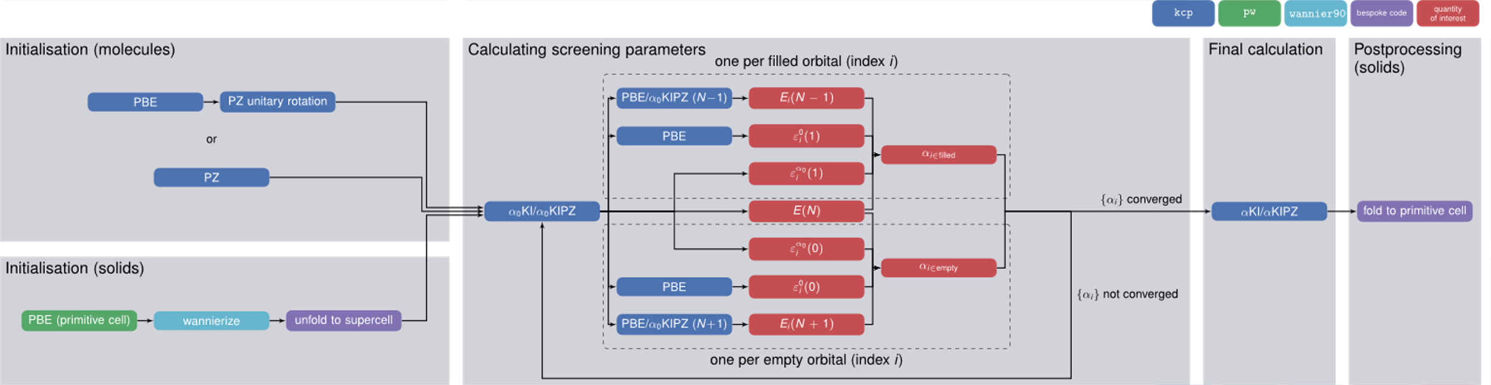
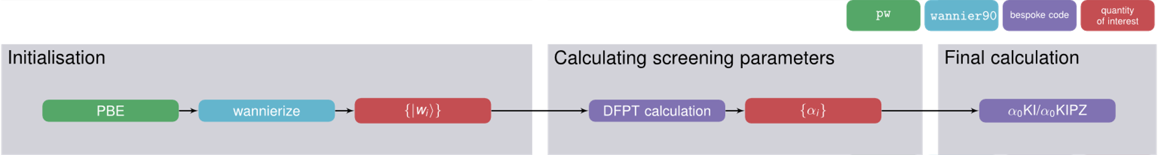
What we will do today
Koopmans calculations using finite differences to calculate screening parameters
Tutorial 1: ozone (via koopmans)
Tutorial 2: silicon (via koopmans)
Koopmans calculations using DFPT to calculate screening parameters
Tutorial 3: ozone (with QE directly)
Tutorial 4: silicon (with QE directly)
Tutorial 5: zinc oxide (with QE directly and via koopmans)

Slide 3
Tutorial #1

Slide 4
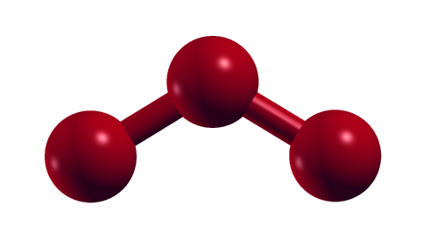
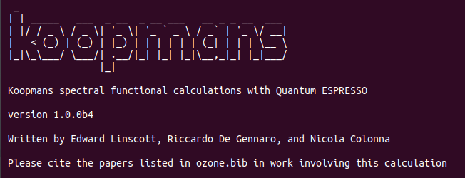
Ozone molecule with KCP
Goal of the tutorial:
compute the charged excitations of the ozone molecule.
Method:
KI functional
Screening parameters computed from finite-energy differences (KCP code)
Main steps:
DFT inizialization
Screening parameters
Final KI calculation
WORKDIR = Day3/exercise1
How to run:
Activate the koopmans virtual environment
conda activate koopmans
Run the calculation
koopmans ozone.json

Slide 5
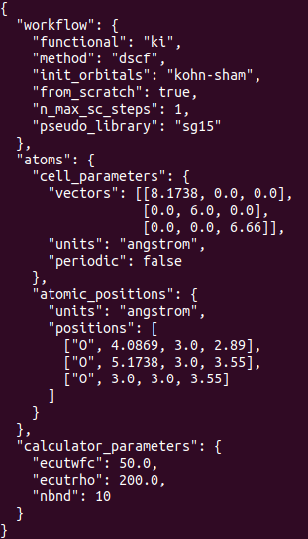
JSON input file
WORKDIR = Day3/exercise1
orbital-density-dependent/density functional to use
(ki, kipz, pkipz, dft, all)
the method to calculate the screening parameters: either dscf or dfpt
which orbitals to use as an initial guess for the variational orbitals
(pz, kohn-sham, mlwfs, projwfs)
max number of self-consistency steps for calculating $α_{i}$
the pseudopotential library to use
(sg15, sg15_relativistic, pseudo_dojo_standard, pseudo_dojo_stringent)
For more info: https://koopmans-functionals.org/en/latest/input_file.html

Slide 6
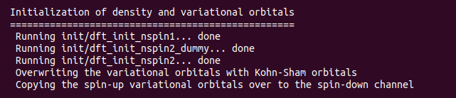
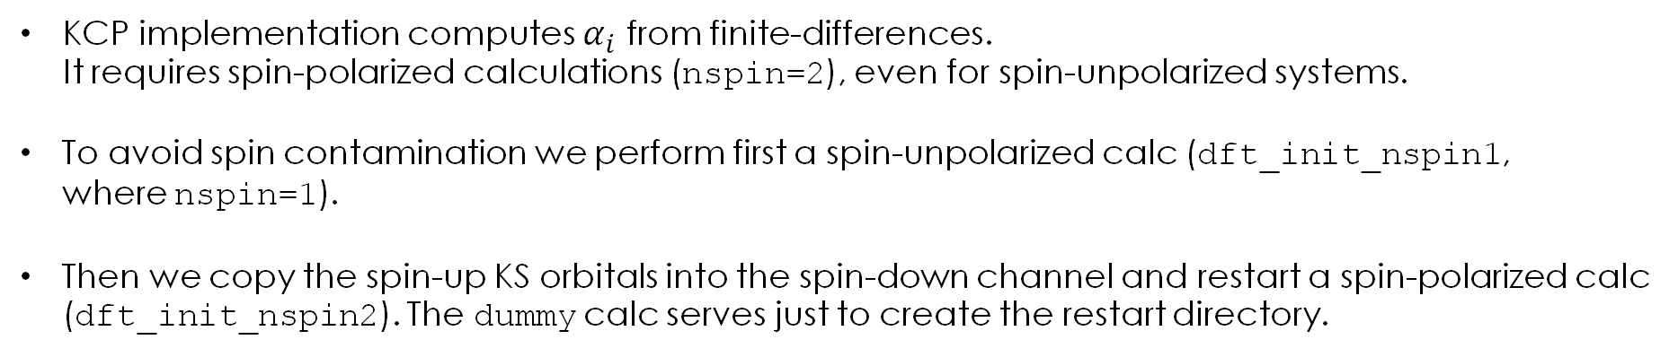
Orbitals initialization
In this tutorial we chose to initialize the variational orbitals to Kohn-Sham.
WORKDIR = Day3/exercise1/init
KCP implementation computes $α_{i}$ from finite-differences. It requires spin-polarized calculations (nspin=2), even for spin-unpolarized systems.
To avoid spin contamination we perform first a spin-unpolarized calc (dft_init_nspin1, where nspin=1).
Then we copy the spin-up KS orbitals into the spin-down channel and restart a spin-polarized calc (dft_init_nspin2). The dummy calc serves just to create the restart directory.

Slide 7
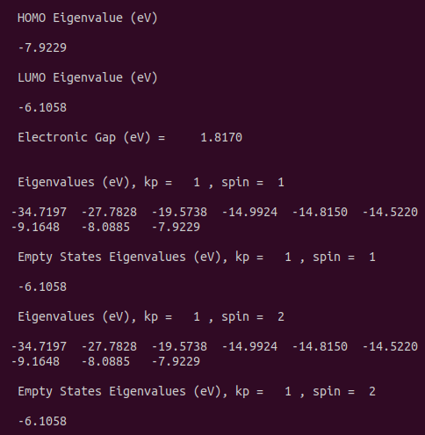
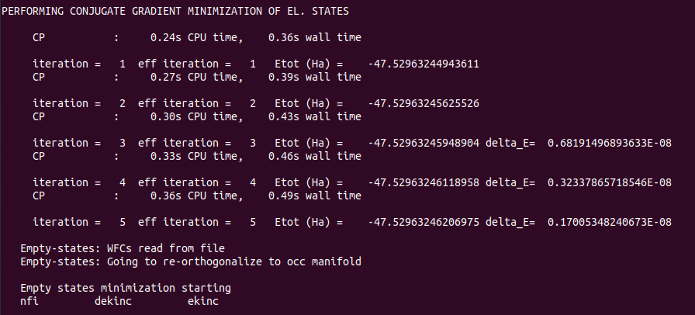
Orbitals initialization
Let’s change directory and go to init.
WORKDIR = Day3/exercise1/init
Let’s open dft_init_spin2.cpo and check the energy minimization and the final eigenvalues (to be compared later with the final KI eigenvalues).
CONVERGED!

Slide 8
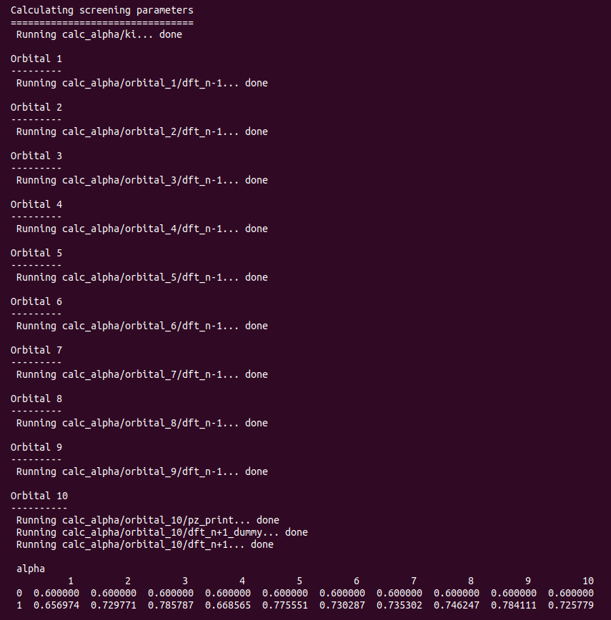
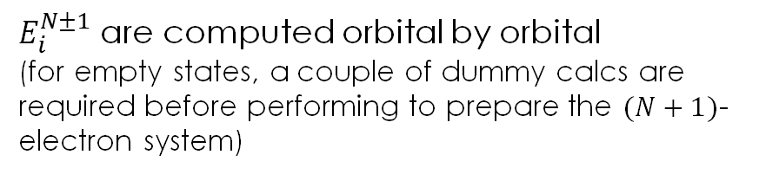
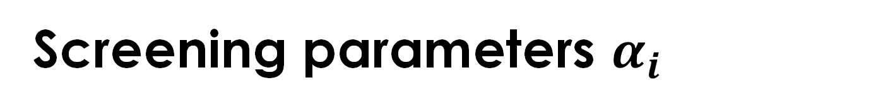
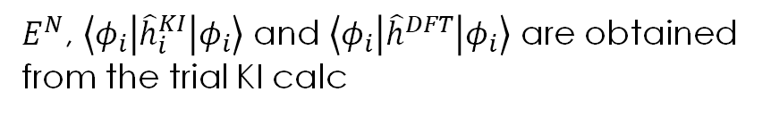
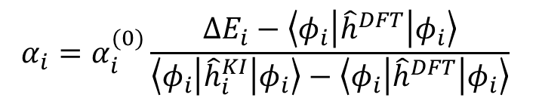
Screening parameters $α_{i}$
The $α_{i}$ are initialized to $α_{i}^{(0)}=0.6$.
WORKDIR = Day3/exercise1/calc_alpha
$$α_{i}=α_{i}^{(0)}\frac{∆E_{i}−\left\langle φ_{i} | {\hat{h}}^{DFT} | φ_{i}\right\rangle }{\left\langle φ_{i} | {\hat{h}}_{i}^{KI} | φ_{i}\right\rangle −\left\langle φ_{i} | {\hat{h}}^{DFT} | φ_{i}\right\rangle }$$
$E^{N}$, $\left\langle φ_{i} | {\hat{h}}_{i}^{KI} | φ_{i}\right\rangle$ and $\left\langle φ_{i} | {\hat{h}}^{DFT} | φ_{i}\right\rangle$ are obtained from the trial KI calc
$E_{i}^{N±1}$ are computed orbital by orbital
(for empty states, a couple of dummy calcs are required before performing to prepare the $(N+1)$-electron system)
Increase n_max_sc_steps for more iterations (unnecessary for KI)

Slide 9
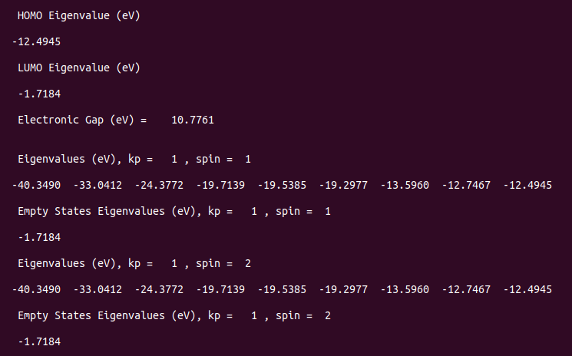
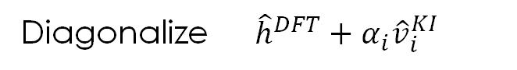
Final KI calculation
Diagonalize ${\hat{h}}^{DFT}+α_{i}{\hat{v}}_{i}^{KI}$
WORKDIR = Day3/exercise1/final
Go to final and open ki_final.cpo
For a more direct comparison KI-vs-DFT you can run the two scripts:
> sh get_BE.sh
> gnuplot BE.gnu

Slide 10
Tutorial #2

Slide 11
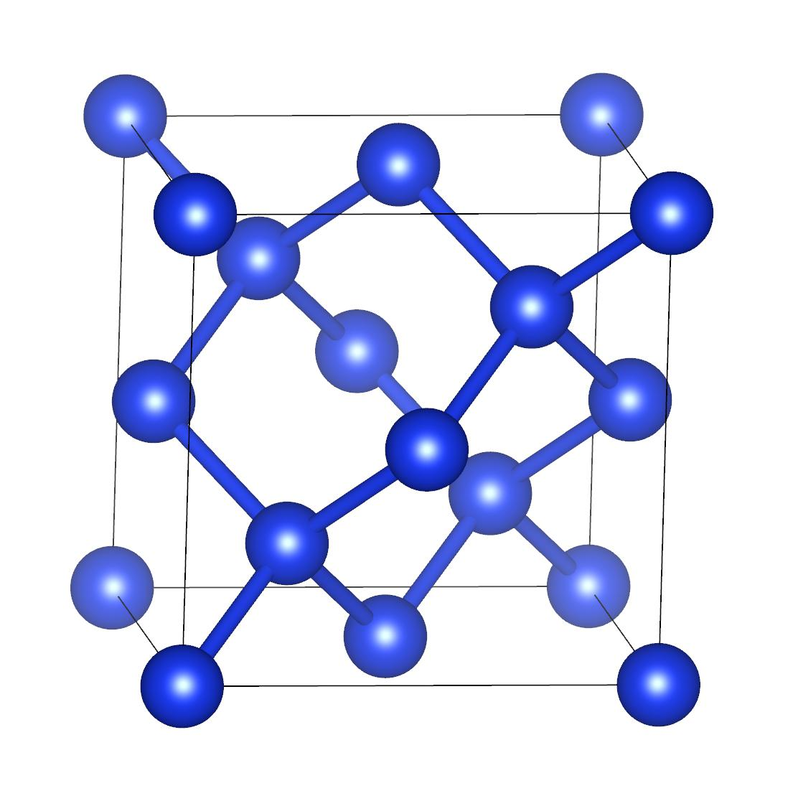
Bulk silicon with KCP
Goal of the tutorial:
compute the band structure of silicon.
Method:
KI and pKIPZ
Screening parameters computed from finite-energy differences (KCP code)
Main steps:
DFT initialization
Maximally localized Wannier functions
Screening parameters
Final KI calculation
Band structure unfolding & interpolation
WORKDIR = Day3/exercise2

Slide 12
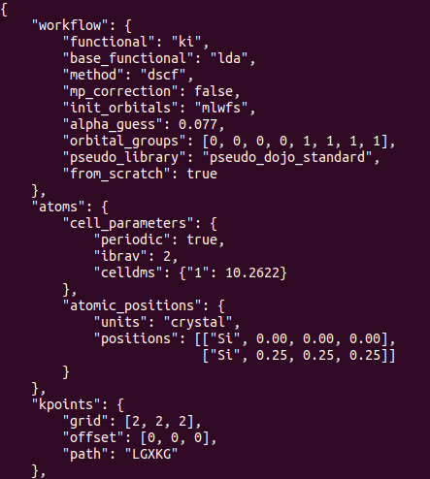
JSON input file
WORKDIR = Day3/exercise2
Activating/deactivating Makov-Payne charge corrections for the N±1 calculations
Initializing orbitals to maximally localized Wannier functions (MLWFs)
Initial guess for α_{i}
Orbitals grouping: tells the workflow how to group the orbitals during the calculation of α_{i}. Usually this requires to know already the form of the variational orbitals, i.e. the MLWFs. In this specific case we have 8 states (4 occ, 4 emp): the 4 occupied MLWFs have a bonding sp3-like form (group 0), while the 4 MLWFs have an antibonding sp3-like form (group 1).
Alternatively, one can define a threshold (orbital_groups_self_hartree_tol) which differentiates between orbitals that have a different self-Hartree energy.
For more info: https://koopmans-functionals.org/en/latest/input_file.html

Slide 13
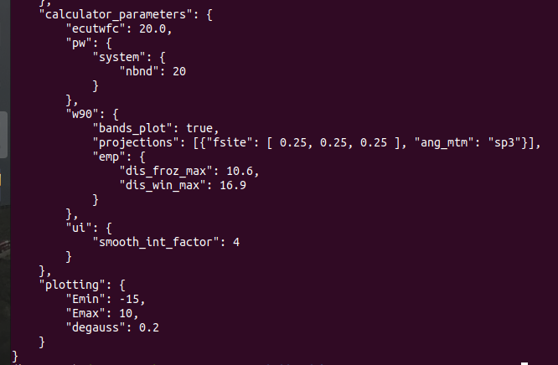
JSON input file
WORKDIR = Day3/exercise2
Num of bands in the initial PW DFT calc, preceding the calculation of MLWFs.
Wannier90 block: projections, disentanglement windows, etc.
Smooth interpolation method (discussed later on)
Plotting block: parameters relevant for the DOS
For more info: https://koopmans-functionals.org/en/latest/input_file.html

Slide 14
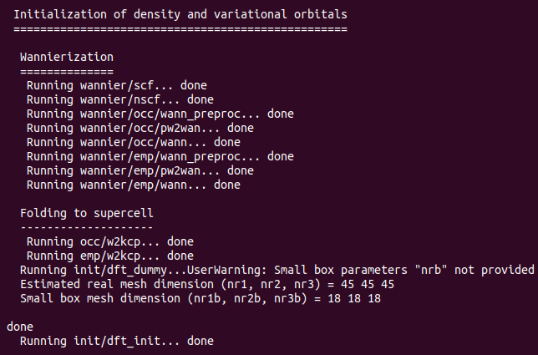
Orbitals initialization
In this tutorial we chose to initialize the variational orbitals to maximally localized Wannier functions (MLWFs).
WORKDIR = Day3/exercise2/init
PW+W90
PC to SC extension of the Wannier functions

Slide 15
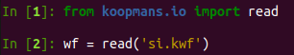
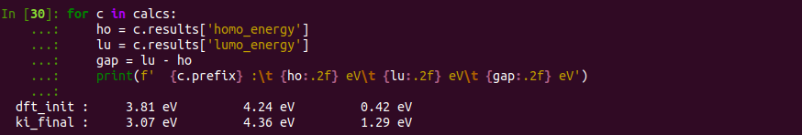
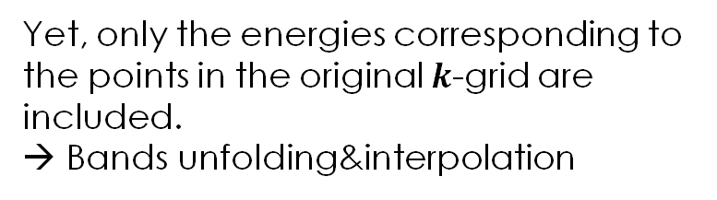
Final KI calculation
Extract results from the .kwf file.
Use python in the interactive mode and run:
WORKDIR = Day3/exercise2/final
wf contains information (including the results of each calculation) of the entire workflow
E.g. wf.calculations contains the list of all the calcs that were run by the workflow.
Yet, only the energies corresponding to the points in the original $k$-grid are included. → Bands unfolding&interpolation
ε_{HO}
ε_{LU}
E_{gap}

Slide 16
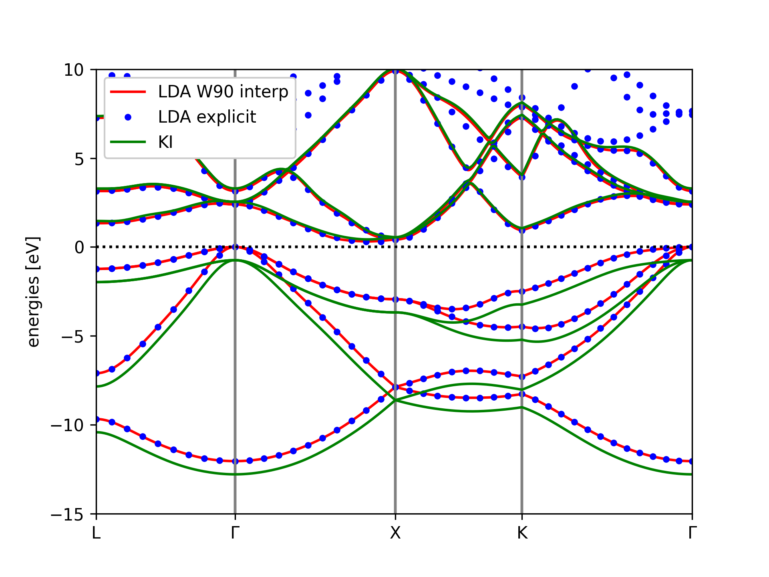
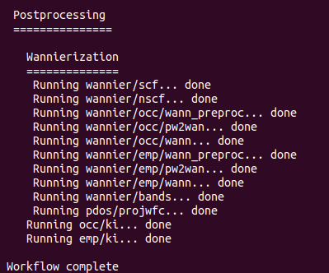
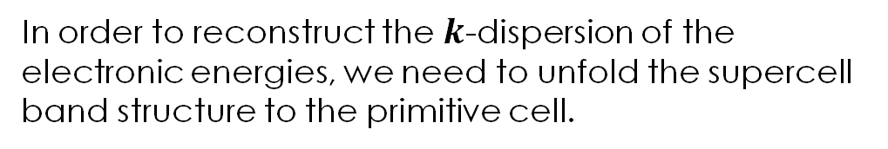
Postproc: band structure
In order to reconstruct the $k$-dispersion of the electronic energies, we need to unfold the supercell band structure to the primitive cell.
WORKDIR = Day3/exercise2/postproc
python plot_bs.py
Notes:
Maybe here, since silicon has an indirect band gap, you can also show the band gap coming from the interpolation to highlight the difference with the band gap showed in the previous slide.

Slide 17
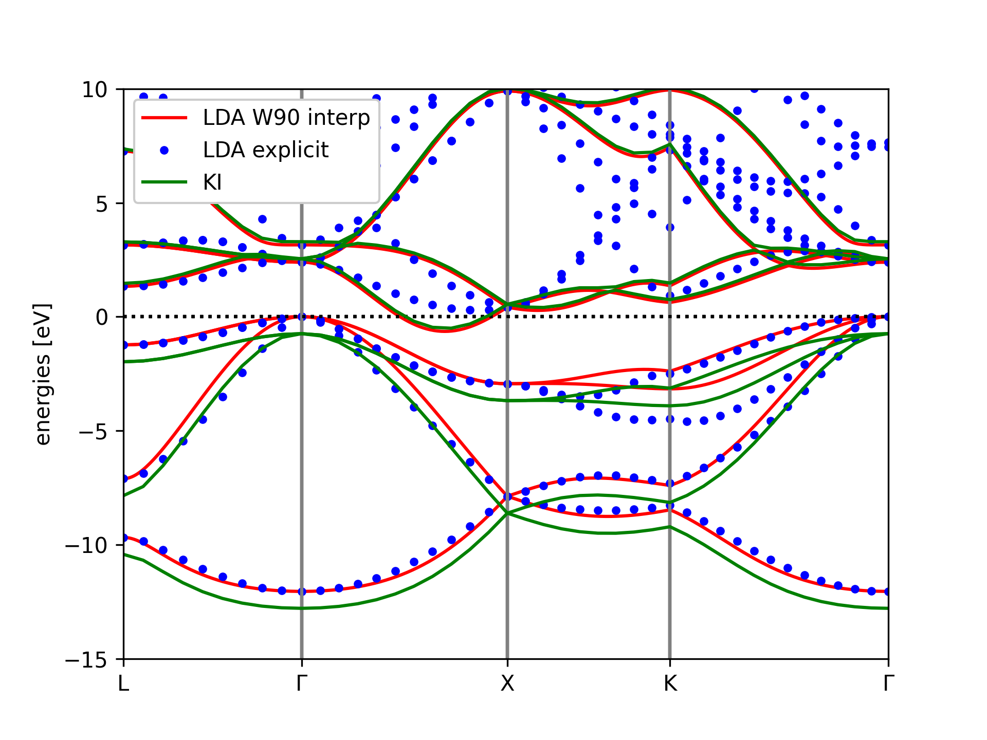
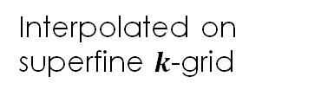
Postproc: smooth interpolation
$$h_{mn}^{KI}\left(k\right)=\sum_{R}{e^{ik∙R}\left\langle w_{m0} | {\hat{h}}^{DFT} | w_{nR}\right\rangle }+\sum_{R}{e^{ik∙R}\left\langle w_{m0} | {\hat{v}}^{KI} | w_{nR}\right\rangle }$$
Interpolated on superfine $k$-grid
Computed on the original supercell
without smooth interpolation
with smooth interpolation

Slide 18
Bonus: pKIPZ calculation
With a few changes you can carry out a perturbative KIPZ calculation:
KIPZ Hamiltonian
KI screening parameters
No further orbitals optimization
Go back to the main dir of the exercise and change in the input JSON file (si.json):
functional from ki to pkipz
from_scratch from true to false
you might want to copy your postproc folder and si.kwf file somewhere else (or just change name) to avoid them to be overwritten
Run koopmans si.json and enjoy your pKIPZ results!

Slide 19
Tutorial #3

Slide 20
Ozone molecule with KCW
Goal of the tutorial:
compute the charged excitations of the ozone molecule.
Method:
KI functional (to 2nd order)
Screening parameters computed from linear response (KCW code)
Main steps:
DFT initialization
Interface to kcw
Screening parameters
Final KI calculation
WORKDIR = Day3/exercise3

Slide 21
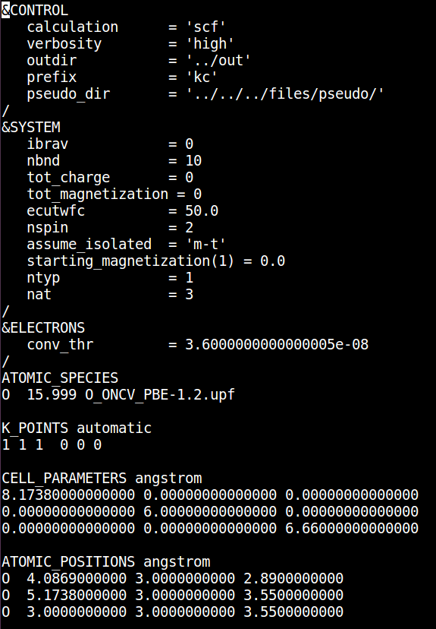
1. DFT initialization
WORKDIR = Day3/exercise3/1_init
executable = pw.x
KCW always requires a calculation in which the spin ​
channel are treated separately (even for spin-unpolarized systems).​ Always set nspin = 2 for a meaningful KCW calculation​
Use the Martyna-Tuckerman scheme to deal with spurious periodic replica interactions
KCW does not support Gamma-point trick
Always use complex wavefunctions.

Slide 22
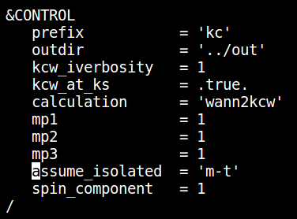
2. Interface to KCW
WORKDIR = Day3/exercise3/1_init
executable = kcw.x
Specify where to find output files from the DFT initialization
Specify we are going to use KS canonical orbitals as the minimizing one
Reasonable choice for finite systems
Specify the kind of calculation:
wann2kcw: interface between PW and W90, and KCW
The Monkhost-Pack grid used in the DFT initialiaztion
Use the Martyna-Tuckerman scheme to deal with spurious periodic replica interactions
Specify which spin channel
https://www.quantum-espresso.org/Doc/INPUT_kcw.html

Slide 23
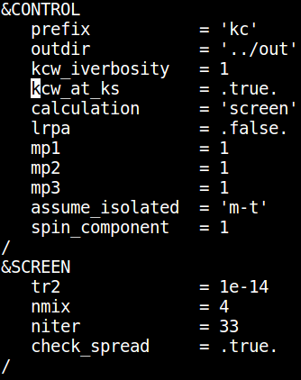
3. Screening parameters α_{i}
WORKDIR = Day3/exercise3/2_screening
executable = kcw.x
Specify the kind of calculation:
screen: compute the screening coefficients
Set it to .true. to neglect xc-effects in the response
Parameters controlling the SCF convergence
Decide whether two orbitals are "equivalent" comparing their spread (self-hartree)
Used to reduce the number of LR calculations
https://www.quantum-espresso.org/Doc/INPUT_kcw.html

Slide 24
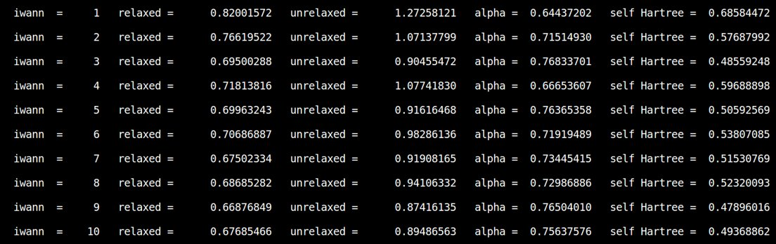
3. Screening parameters α_{i}
Inspect the kc.kso output file
Screening coefficients

Slide 25
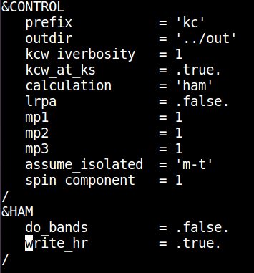
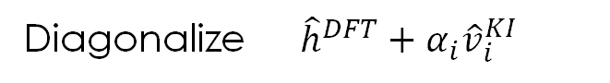
4. Final KI calculation
Diagonalize ${\hat{h}}^{DFT}+α_{i}{\hat{v}}_{i}^{KI}$
WORKDIR = Day3/exercise3/3_hamiltonian
executable = kcw.x
All the &CONTROL parameters need to be consistent all along the different kcw calculations (wann2kcw, screen, and ham)
Specify the kind of calculation:
ham: compute and diagonalize the KI hamiltonian
Write the KI hamiltonian H(R) on a formatted file similar to that produced by Wannier90
https://www.quantum-espresso.org/Doc/INPUT_kcw.html

Slide 26
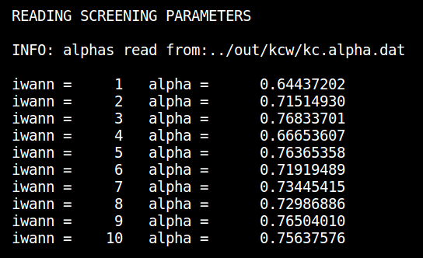
4. Final KI calculation
Inspect the output file: kc.kho
WORKDIR = Day3/exercise3/3_hamiltonian
executable = kcw.x
File produced by the previous screen calculation

Slide 27
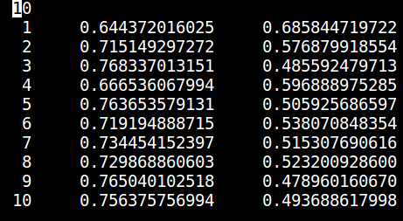
4. Final KI calculation
Inspect the output file: kc.kho
WORKDIR = Day3/exercise3/3_hamiltonian
executable = kcw.x
File produced by the previous screen calculation
Alternatively one can specify the alpha parameters in a file named file_alpharef.txt to be placed in the working directory (this has the priority)
Total number of orbitals
Screening Coefficients
Self-Hartree

Slide 28
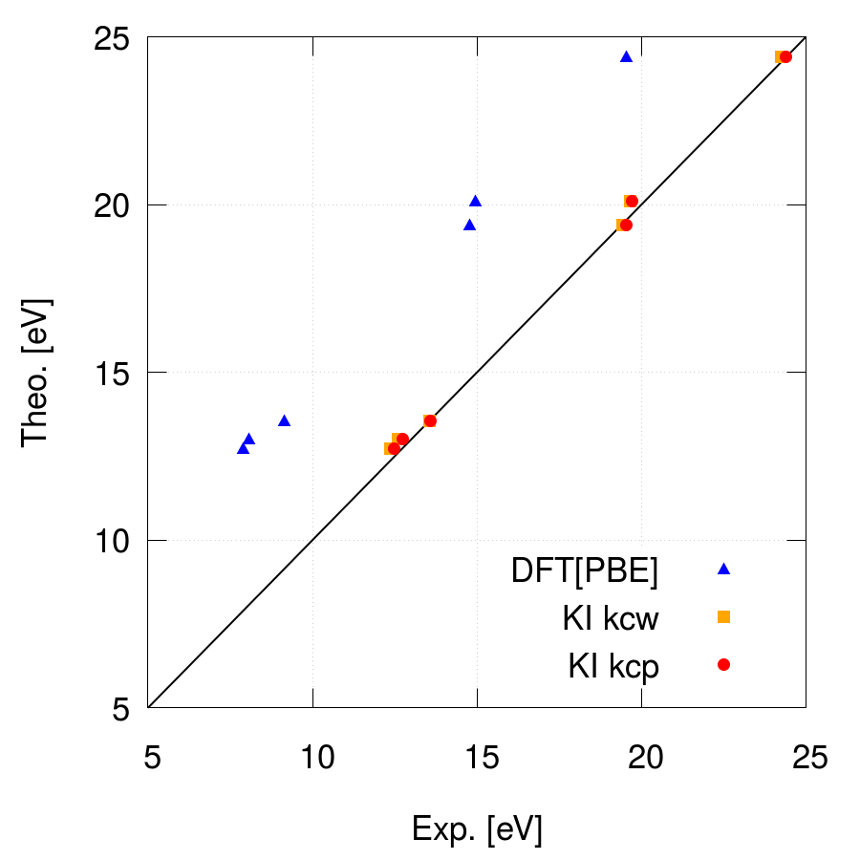
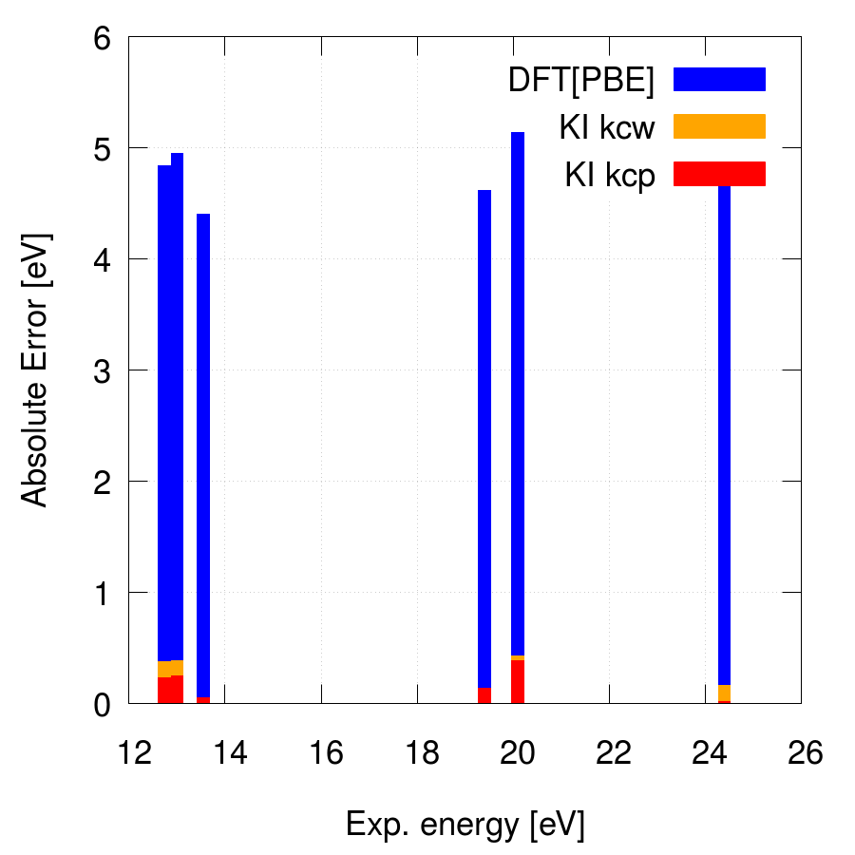
Final KI calculation
Inspect the output file: kc.kho
For a more direct comparison KI-vs-DFT you can run the two scripts:
> sh get_BE.sh
> gnuplot BE.gnu

Slide 29
Tutorial #4

Slide 30
Bulk silicon with KCW
Goal of the tutorial:
compute the band structure of silicon.
Method:
KI
Screening parameters computed from linear response (KCW code)
Main steps:
DFT calculation
Maximally localized Wannier functions
Screening parameters
Final KI calculation
Band structure interpolation with Wannier90
WORKDIR = Day3/exercise4

Slide 31
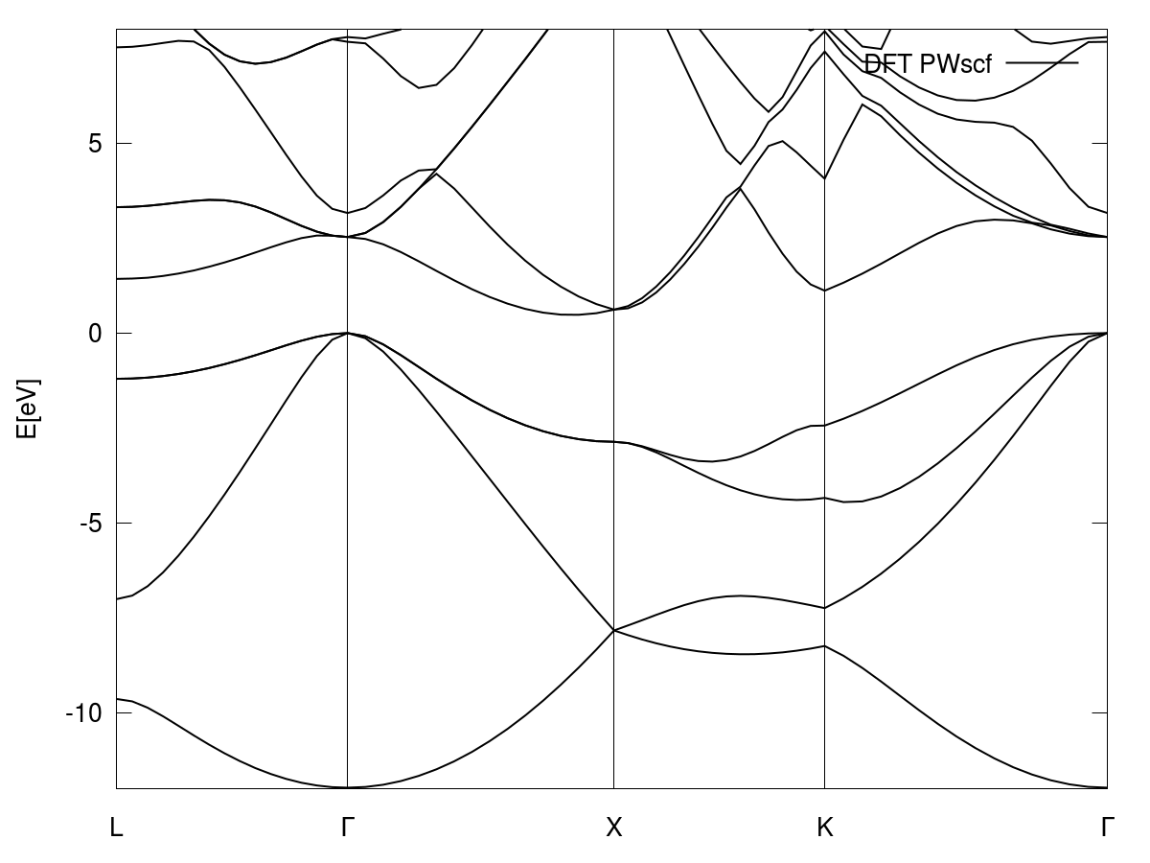
0. LDA band structure
WORKDIR = Day3/exercise4/0_dft
executables = pw.x and bands.x
​ | indirect​ | direct​
E_{g} LDA.​​ | 0.48 | 2.53
E_{g} Exp.​​ | 1.17​​ | 3.35​​

Slide 32
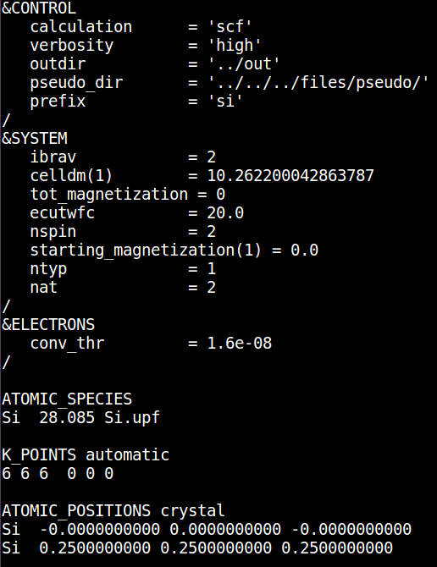
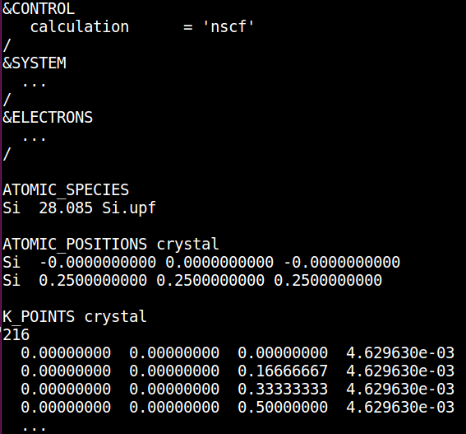
1. DFT initialization
SCF calculation
WORKDIR = Day3/exercise4/1_init
executable = pw.x
Always set nspin = 2 for a meaningful KCW calculation​
NSCF calculation
NSCF on a regular 6x6x6
k-point grid ( you can use the kmesh.pl utility of W90)

Slide 33
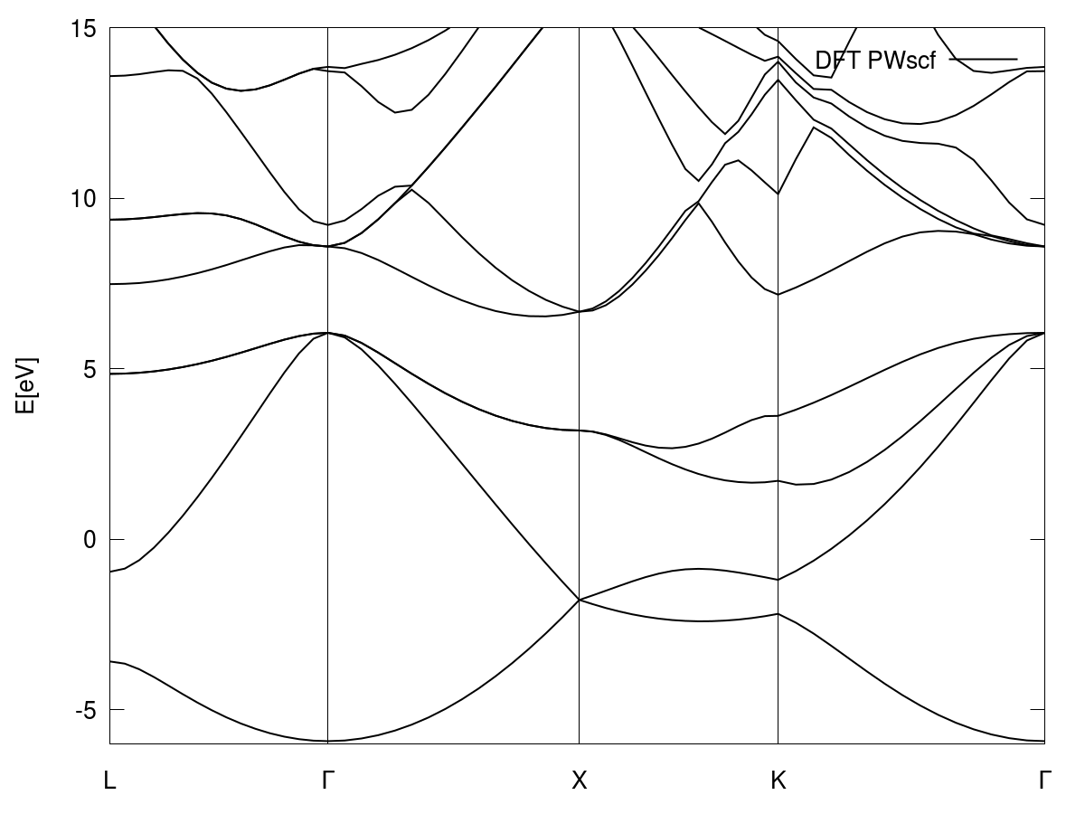
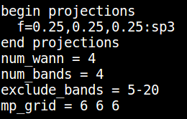
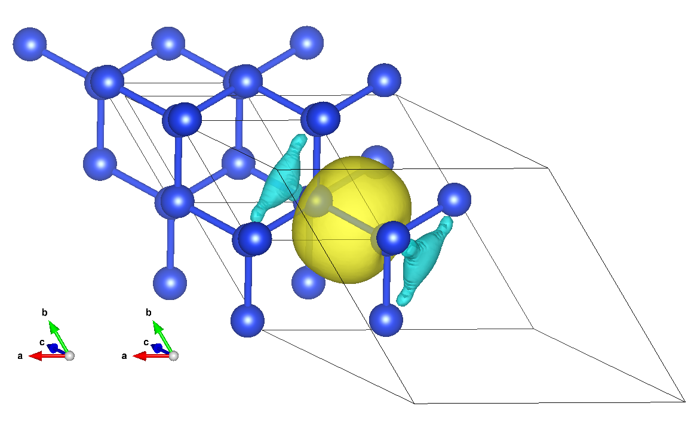
2. Wannierization
WORKDIR = Day3/exercise4/1_init/occ
executable = wannier90.x, pw2wannier90.x
Occupied Manifold
4 MLWFs out of 4 bands
Exclude all the empty states
Use 4 sp³ atomic orbital centered at (0.25, 0.25, 0.25) as
initial guess

Slide 34
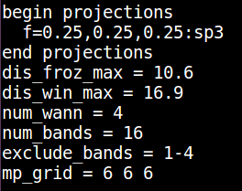
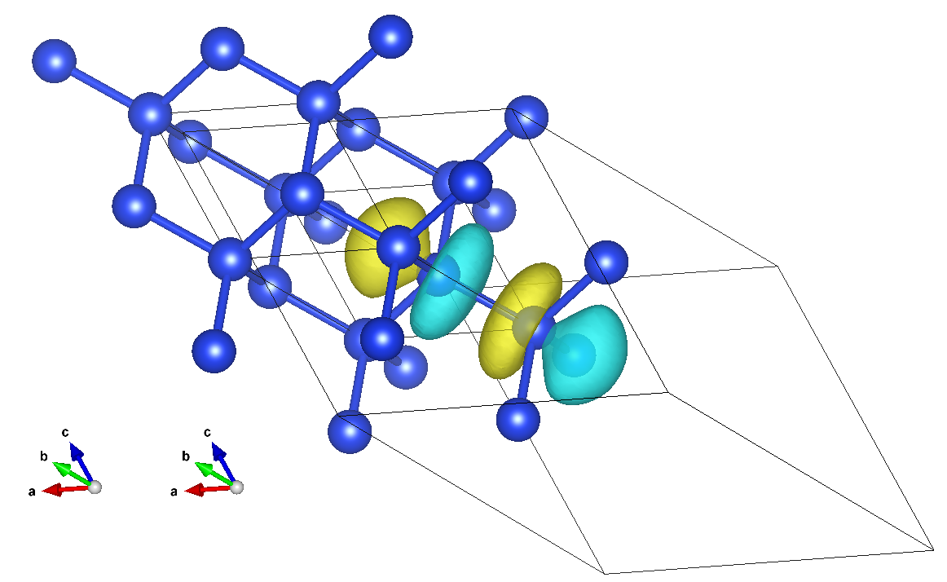
2. Wannierization
WORKDIR = Day3/exercise4/1_init/occ
executable = wannier90.x, pw2wannier90.x
Empty Manifold
4 MLWFs out of 16 bands (disentanglement needed!)
Exclude all the occupied states
Use 4 sp³ atomic orbital centered at (0.25, 0.25, 0.25) as
initial guess

Slide 35
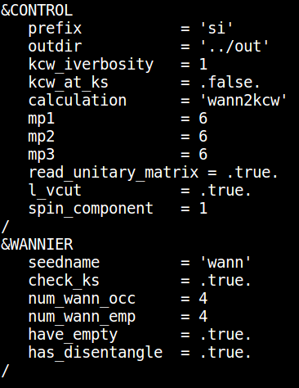
2. Interface to KCW
WORKDIR = Day3/exercise4/1_init
executable = kcw.x
Specify where to find output files from the DFT initialization
Specify we are going to use something different from KS orbitals as the minimizing ones.
This will be MLWF: reasonable choice for extended systems
Use the Gygi-Baldereschi scheme to deal with the long-range coulomb interactions
Specify where to find output files from W90 (essentially the unitary matrices)
Number of occ and empty MLWFs
https://www.quantum-espresso.org/Doc/INPUT_kcw.html

Slide 36
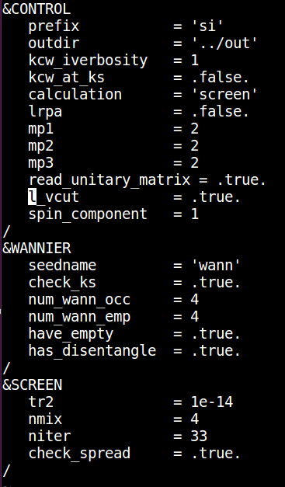
3. Screening parameters α_{i}
WORKDIR = Day3/exercise4/2_screening
executable = kcw.x
Screening coefficients on a reduced k-mesh (requires
to re-do the Wannierization on the reduced mesh)
Parameters controlling the SCF convergence
https://www.quantum-espresso.org/Doc/INPUT_kcw.html

Slide 37
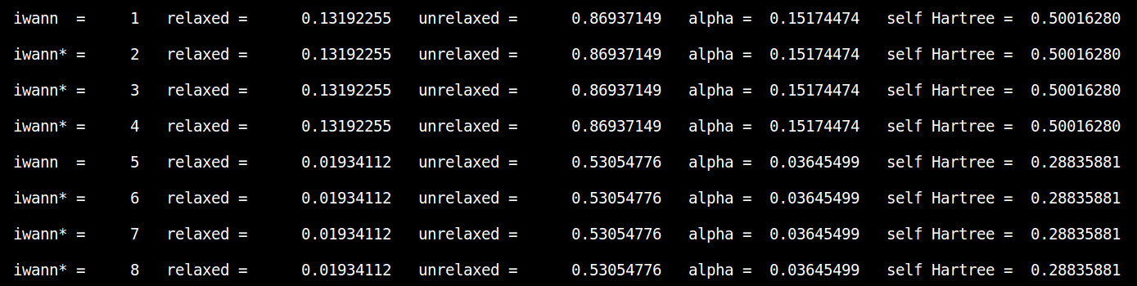
3. Screening parameters α_{i}
Inspect the kc.kso output file
Screening coefficients

Slide 38
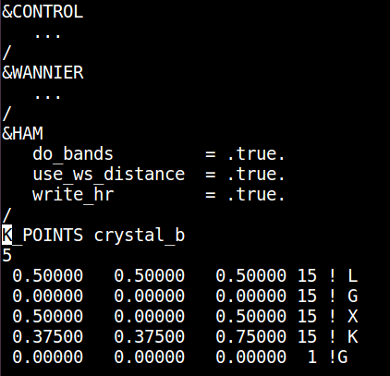
4. Final KI calculation
Diagonalize ${\hat{h}}^{DFT}+α_{i}{\hat{v}}_{i}^{KI}$
WORKDIR = Day3/exercise4/3_hamiltonian
executable = kcw.x
All the &CONTROL parameters need to be consistent all along the different kcw calculations (wann2kcw, screen, and ham)
Use the MLWFs to interpolate the band structure
on an arbitrary path
https://www.quantum-espresso.org/Doc/INPUT_kcw.html

Slide 39

4. Final KI calculation
WORKDIR = Day3/exercise4/3_hamiltonian
executable = kcw.x
​ | indirect​ | direct​
E_{g} LDA.​​ | 0.48 | 2.53
E_{g} KI.​​ | ?? | 3.47
E_{g} Exp.​​ | 1.17​​ | 3.35​​
Better interpolation with an extra unique (occ+empty) wannierization

Slide 40


5. Wannierization (post-proc)
WORKDIR = Day3/exercise4/3_hamiltonian/wannier_post
executable = wannier90.x, pw2wannier90.x
8MLWFs out of 8 bands
(NO disentanglement needed!)
Use randomly-centred s-type Gaussian function as initial guess
​ | indirect​ | direct​
E_{g} LDA.​​ | 0.48 | 2.53
E_{g} KI.​​ | 1.30 | 3.45
E_{g} Exp.​​ | 1.17​​ | 3.35​​
Even better interpolation possible using the smooth-interpolation technique (see tutorial #2)

Slide 41
Tutorial #5

Slide 42

Wurtzite ZnO with KCW
Goal of the tutorial:
compute the band structure of ZnO
Method:
KI
Screening parameters computed from linear response (KCW code)
Main steps:
DFT calculation
Projected Wannier functions
Screening parameters
Final KI calculation
WORKDIR = Day3/exercise5

Slide 43


0. LDA band structure
WORKDIR = Day3/exercise5/0_dft
executables = pw.x and bands.x
​ | Gap | d-states
LDA.​​ | 0.70 | -5.1
Exp.​​ | 3.60 | -7.5 / -8.0

Slide 44


1. DFT initialization
SCF calculation
WORKDIR = Day3/exercise5/1_init
executable = pw.x
Always set nspin = 2 for a meaningful KCW calculation​
NSCF calculation
NSCF on a regular 4x4x4
k-point grid (disabling all the symmetries)

Slide 45


2. Wannierization
WORKDIR = Day3/exercise5/1_init/occ
executable = wannier90.x, pw2wannier90.x
Occupied Manifold
No minimization to avoid orbital mixing
Exclude all the empty states

Slide 46

2. Wannierization
WORKDIR = Day3/exercise4/1_init/occ
executable = wannier90.x, pw2wannier90.x
Empty Manifold
2 Projected WFs out of 26 bands (disentanglement needed!)
Exclude all the occupied states
Use 2 s atomic orbital centered on the Zn atoms as
initial guess

Slide 47

2. Interface to KCW
WORKDIR = Day3/exercise5/1_init
executable = kcw.x
Specify where to find output files from the DFT initialization
Specify we are going to use something different from KS orbitals as the minimizing ones.
This will be MLWF: reasonable choice for extended systems
Use the Gygi-Baldereschi scheme to deal with the long-range coulomb interactions
Specify where to find output files from W90 (essentially the unitary matrices)
Number of occ and empty MLWFs
https://www.quantum-espresso.org/Doc/INPUT_kcw.html

Slide 48

3. Screening parameters α_{i}
WORKDIR = Day3/exercise5/2_screening
executable = kcw.x
Screening coefficients on a reduced k-mesh (requires
to re-do the Wannierization on the reduced mesh)
Parameters controlling the SCF convergence
Use the value of the macroscopic dielectric function to improve the convergence wrt k/q-point sampling
eps_inf computed with ph.x
https://www.quantum-espresso.org/Doc/INPUT_kcw.html

Slide 49

3. Screening parameters α_{i}
Inspect the kc.kso output file
Screening coefficients

Slide 50

4. Final KI calculation
Diagonalize ${\hat{h}}^{DFT}+α_{i}{\hat{v}}_{i}^{KI}$
WORKDIR = Day3/exercise5/3_hamiltonian
executable = kcw.x
All the &CONTROL parameters need to be consistent all along the different kcw calculations (wann2kcw, screen, and ham)
Use the MLWFs to interpolate the band structure
on an arbitrary path
https://www.quantum-espresso.org/Doc/INPUT_kcw.html

Slide 51

4. Final KI calculation

Slide 52

4. Final KI calculation
WORKDIR = Day3/exercise5/3_hamiltonian
executable = kcw.x
​ | Gap | d-states
LDA.​​ | 0.70 | -5.1
KI | 3.4 | -7.5
Exp.​​ | 3.60 | -7.5 / -8.0

Slide 53

5. Using koopmans
Now, instead of running everything by hand, let's use koopmans
In the directory Day3/exercise5/automated you will find the input JSON file
Now use DFPT compared to the finite difference approach
For the sake of time we'll skip the calculation of the screening parameters and instead provide some pre-computed values here

Slide 54

5. Using koopmans
As before, run koopmans zno.json to run the entire workflow You will see some familiar steps...
DFT initialisation
Wannierisation (now block-by-block MLWFs to avoid mixing)
(generate a PDOS plot)
convert to KCW format
The screening parameters would appear here if we weren't skipping them
Final KI calculation

Slide 55


5. Using koopmans
The workflow will generate a basic band structure plot
We can use the script plot_bandstructure.py to generate a nicer figure
Colonna et al. 2022 (JCTC)

Slide 56
Want to find out more?
Website (for documentation, papers to read, and more)
koopmans-functionals.org
Google group (for asking questions)
groups.google.com/g/koopmans-users
Github repository (for reporting bugs or contributing new features)
github.com/epfl-theos/koopmans

